Slide 1
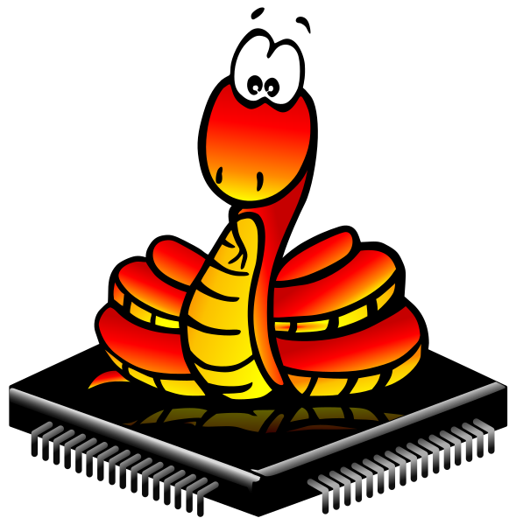
Micropython on spike prime
BY SANJAY AND ARVIND SESHAN

Slide 2
Lesson Objectives
Learn how to use MicroPython REPL on SPIKE Prime
To create full programs in VS Code to run on the hub follow the instructions at https://github.com/sanjayseshan/spikeprime-vscode/wiki

Slide 3
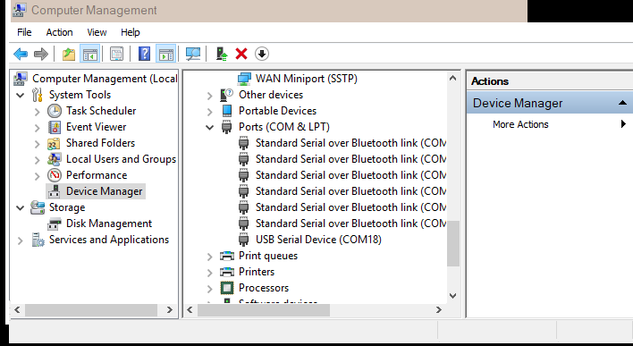
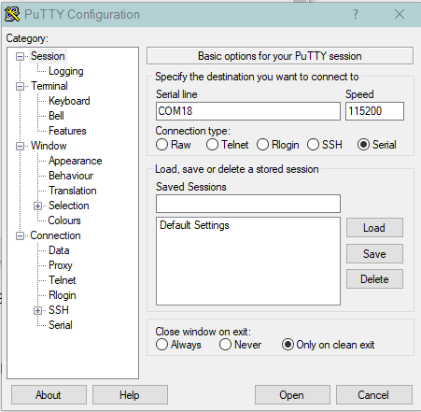
Step 1: Connect (Windows)
Install any terminal emulator of your choice
Example: PuTTY https://www.putty.org/
Make sure your SPIKE Prime software is not running
Connect the Hub via USB port to your computer
Find the port
On a PC, look in your device manager (in start menu→ Windows Administrative Tools→ Computer Management→ Device Manager) under serial to see what serial ports you have connected
If you have multiple USB serial ports try disconnecting and reconnecting to see which one appears
Connect to the right port at 115200 baud

Slide 4
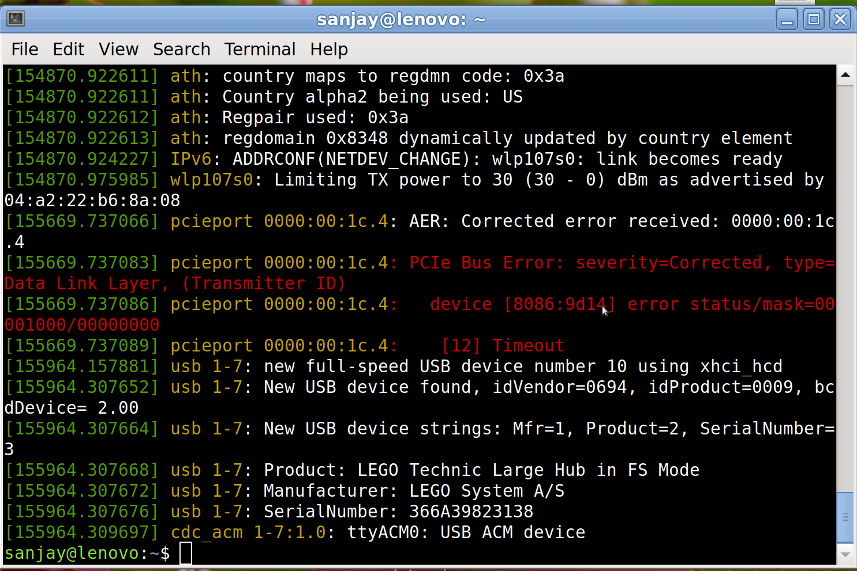
Step 1: Connect (Debian GNU/Linux)
Open terminal – This can be found in Applications → System Tools usually
Type in the following commands (this is for Debian and derivatives):
sudo apt-get update
sudo apt-get install –y screen
Plug in your hub and run sudo dmesg. A long list of log messages will show up. The last line(or close to last) should contain USB ACM device and the id similar to ttyACM0. If you cannot find it, first look for LEGO Technic Large Hub.
Run sudo screen /dev/ttyACM0 115200. Replace ttyACM0 with your id.

Slide 5
Step 1: Connect (Mac os x)
Open terminal – This can be found in Applications → Utilities usually
Run ls /dev/ | fgrep usb | fgrep tty to find the hub port
Run screen /dev/tty.usbmode366A398231381 115200. Replace tty… with the output of the first command. If there were multiple outputs, try all of them until you get the right one.
Below is an example of the commands being run. The computer output is in green, the commands you type are in black.
$ ls /dev | fgrep usb | fgrep tty
tty.usbmodem366A39831234
$ screen /dev/tty.usbmodem366A39831234

Slide 6
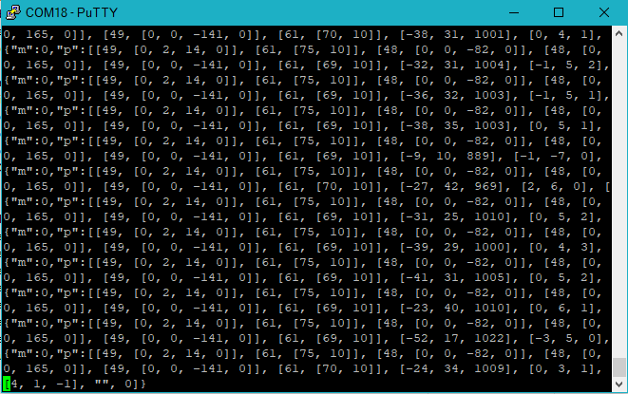
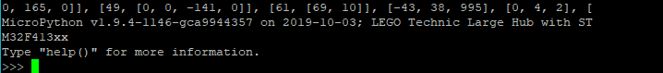
STEp 2
You may see a lot of numbers scroll by. This is the sensor and motor log.
Hit Control-C
You will be ready to program

Slide 7
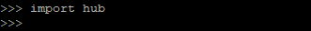
Hub Module
The “hub” python module contains all the key functions/objects that are necessary to interact with the SPIKE Prime hub.
To access this module, you must first “import” the module. Type “import hub” at the MicroPython prompt
Once you have imported hub, you can explore some of the interfaces it exposes using autocompletion. Type “hub.” (make sure to include the period) and then hit the “Tab” button
>>> hub.
__class__ __name__ __version__ BT_VCP
Image USB_VCP battery ble
bluetooth button display info
led motion port power_off
sound status supervision temperature

Slide 8
Help Command
The on-brick MicroPython also provides a limited help tool. To access help, type “help()”
>>> help()
Welcome to MicroPython!
For online help please visit http://micropython.org/help/.
Quick overview of commands for the board:
hub.info() -- print some general information
hub.status() -- print sensor data
Control commands:
CTRL-A -- on a blank line, enter raw REPL mode
CTRL-B -- on a blank line, enter normal REPL mode
CTRL-C -- interrupt a running program
CTRL-D -- on a blank line, do a soft reset of the board
CTRL-E -- on a blank line, enter paste mode
For further help on a specific object, type help(obj)
For a list of available modules, type help('modules')

Slide 9
Other Modules/Libraries
Type the help(‘modules‘) command (make sure to type the quotes)
This provides a list of modules that are available on the SPIKE Prime
>>> help('modules')
__main__ heapq struct umachine
_onewire hub sys uos
array io time urandom
binascii json ubinascii ure
builtins machine ucollections uselect
cmath math uctypes ustruct
collections micropython uerrno utime
errno os uhashlib utimeq
firmware random uheapq uzlib
gc re uio zlib
hashlib select ujson
Plus any modules on the filesystem

Slide 10
Other Modules/Libraries
You can use the import command to load any of the libraries you find and then use autocompletion or help() to explore their functions
>>> import random
>>> help(random)
object <module 'urandom'> is of type module
__name__ -- urandom
getrandbits -- <function>
seed -- <function>
randrange -- <function>
randint -- <function>
choice -- <function>
random -- <function>
uniform -- <function>
>>> random.random()
0.711182
>>> random.random()
0.408947

Slide 11
CHALLENGE 1: HELLO WORLD
Print “Hello World” on your Hub Light Matrix
Some key steps:
Import the hub module
Explore the components of the hub to find one that controls the Light Matrix (hint: you want to “display” something)
Finally, look for a method that “shows” something on the display

Slide 12
CHALLENGE 1: HELLO WORLD
Print “Hello World” on your Hub Light Matrix
>>> import hub
>>> hub.
__class__ __name__ __version__ BT_VCP
Image USB_VCP battery ble
bluetooth button display info
led motion port power_off
sound status supervision temperature
>>> hub.display.
__class__ callback clear pixel
rotation show
>>> hub.display.show('Hello World')

Slide 13
CREDITS
This lesson was created by Sanjay Seshan and Arvind Seshan for SPIKE Prime Lessons
More lessons are available at www.primelessons.org
This work is licensed under a Creative Commons Attribution-NonCommercial-ShareAlike 4.0 International License.

